Slide 1

Streaming data and its integration in Novel big data engines
Presented by Naveen Kumar Vadlamudi
As a part of Course Research Project 5660

Slide 2

What is Stream Processing ?
Streaming data refers to a continuous flow of data from a source to a destination in real-time.
Example: IOT sensors streaming continuous data to servers.
To handle this special kind of data we have multiple tools, such as Apache Kafka, Apache Spark, and Apache Flink. Therefore i am going to discuss these later in presentation.

Slide 3

What is time series data?
A data model that encapsulates data purely based on change of time.

Slide 4
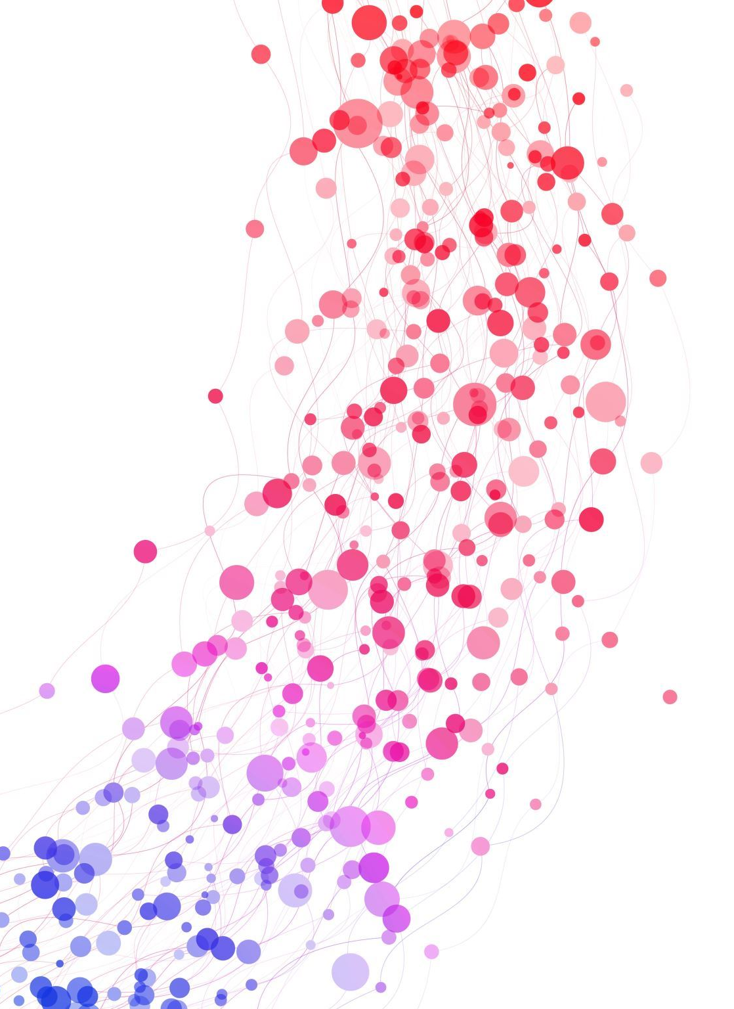
What is the relation between streaming data and time series model?

Slide 5
Can we think the above mentioned model and type are equivalent !

Slide 6

Lets see a Scenario
Lets assume a BCI (Brain Computer Interface) device is connected to a human brain, and now we try to capture the data!
The process of setting up a live data pipeline from a brain to a computer is called stream setup.
Therefore the streaming, of data is a type of system we are using for ingestion.
Whereas, the data that is accrued in a system is a time series data model.

Slide 7
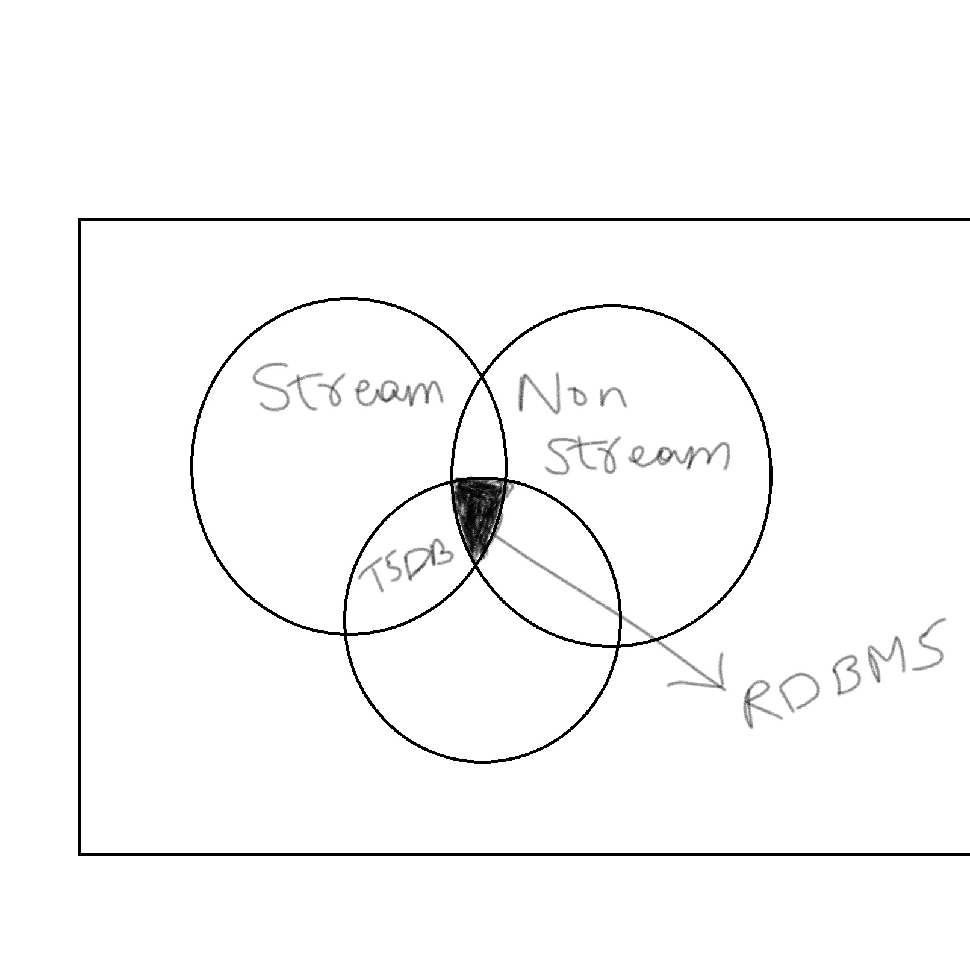
This solves everything
Time series is a subset of a streaming data.

Slide 8
As we have understood what is timeseries and streaming data we will now look at another problem
Questioning Big data ?

Slide 9

What is Big data ?
Any data that satisfies the properties of 5 V's (Volume, Velocity, Variety, Value and Veracity) is called a Big data.
Example: It is not confined to a single table, or a single file that is huge, but instead if any particular data item satisfies the above-mentioned criteria partially or completely then it is considered to be big data.

Slide 10
Papers we are going to discuss
Firstly, let us solidify our fundamentals by understanding more about stream processing papers.
In order to do that, lets first discuss CQL paper.
Next, we will look into tsdb a Time series database.
Then after we will move on to Kafka.
Subsequently, we will discuss about, Apache Spark.
Later, Apache Flink
Lastly, we will understand how Uber process PB(Petabyte) of data at scale.

Slide 11

Continuous Queries over Data Streams
The authors Widom et al. discuss the need for novel architecture in streaming data, by contrasting existing approaches in RDBMS.
Hence they proposed a novel architecture that leverages the properties of Materialized views to process incoming streaming data.

Slide 12
Why existing systems were incapable?
Many computer scientists did propose, multiple variants of stream processing techniques, such as Xpath, Xyleme that has their own query language.
Limitations are numerous, as they are confined to a specific file format and have scalability issues.

Slide 13
That’s the reason they proposed CQL
A novel architecture to process streaming data effectively and efficiently

Slide 14
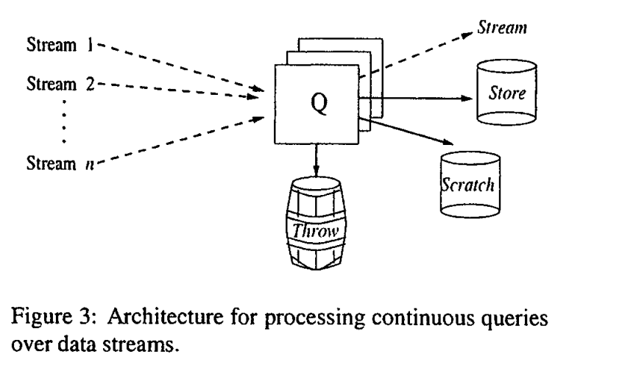
Proposed – CQL Architecture
The Proposed architecture contains 4 components.
Stream: Incoming tuples are sent to the Stream component.
Store: Tuples which are not anticipated to be present in the result are sent to store component.
Scratch: Scratch stores the tuples in memory to query back the results quickly.
Throw: Garbage collected and unused rows are sent to the throw component.

Slide 15

tsdb: A Compressed Time Series Database
Proposed by Luca Deri et al. to address the challenge of network monitoring.
That resulted in creation a new database named tsdb, which is highly optimized for reading and writing time series data concurrently.
Tsdb utilizes the RRDs(Round Robin Database) performance for time series data and customizes it accordingly, to process concurrent time series data that supports high cardinality.

Slide 16

Limitations of Existing methods - tsdb
Existing relational databases are not a good fit in network monitoring applications.
As the data is not characterized by many relationships. Instead, the records are repeated over time at frequent intervals, increasing the cardinality of a table and making handling indexes extremely hard.
Therefore, specialized databases like Round Robin Database (RRD) have been developed to handle time series data, where each RRD has a file with a size of 64 KB. However, RRD has performance limitations such as the inability to handle a large number of concurrent RRDs.

Slide 17

Tsdb properties
Efficient Data compression
Open source
High cardinality data support
Distributed and Scalable

Slide 18

Core principles of TSDB
capacitating millions of time series using minimal append operations
1
adding and removing time series as needed without reconfiguring data
2
avoiding data consolidation during append, similar to RRD database
3
providing compressed data storage for all time series using a single file.
4

Slide 19
Data organization and performance
It accrues multiple ranges of time series, as a chunk of 10 K records per set and stores them as a key-value pair to optimize the space, and performs compression.
Overall Tsdb out performs all the existing databases such as Redis, Mysql, making it highly optimized for time series data.

Slide 20

Kafka – A unified log processing engine
Proposed by Kreps et al. to handle the internal log workloads at LinkedIn.
Uses distributed computing architecture to process log data in real-time.
It uses the producer, consumer and broker models to pull and push the data.

Slide 21
Limitations of Existing Systems
According to the authors, the existing log processing engines such as IBM Websphere, contain transactional support that allows an application to insert messages into multiple queues atomically.
Resulting the system performance to degrade.
As it uses locks to validate the data and consistency.
JMS (Java Messaging Service) engine uses acknowledgement
to, verify whether the data is delivered or not.

Slide 22
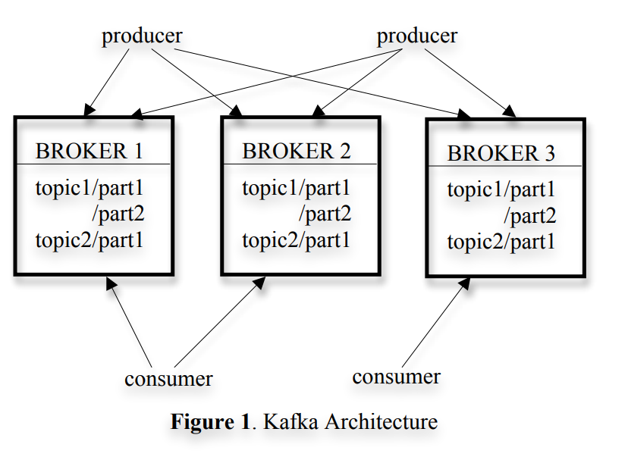
Architecture of Kafka
The core of the architecture is Producer and broker.
Producer: Produces the data it is also considered as source.
Broker: Broker distributes, and stores incoming data to its replicas as a partitioned segment file with an offset, based on the topic it is subscribed to.
Consumer: Consumes the data reliably.
Image source from paper

Slide 23
Kafka Broker Functionalities
Store and manage Kafka topic partitions: A Kafka broker is responsible for storing and managing the topic partitions of a Kafka cluster. It receives messages from producers and stores them in the appropriate partition(s) based on the message key.
Serve consumer requests: Kafka brokers serve read requests from consumers by sending messages from the topic partitions they manage. They also maintain the offsets for each consumer group, allowing consumers to read from where they left off.
Replicate data across brokers: Kafka brokers replicate data across the cluster to provide fault tolerance and ensure high availability. Each partition has a leader broker that receives all write requests, and the leader replicates the messages to its followers.

Slide 24
Kafka Broker Functionalities – Cont.
Manage and maintain metadata: Kafka brokers maintain metadata about the Kafka cluster, including information about topics, partitions, and replicas. They also respond to metadata requests from producers and consumers.
Manage quotas: Kafka brokers can be configured to enforce quotas on the amount of data that can be produced or consumed by clients. This allows administrators to manage resources and prevent clients from overwhelming the cluster.
Handle administrative tasks: Kafka brokers can perform administrative tasks such as creating and deleting topics, modifying topic configurations, and managing access control lists (ACLs) to secure the Kafka cluster.
Monitor and report metrics: Kafka brokers report various metrics related to the health and performance of the cluster. These metrics can be used to monitor the cluster and troubleshoot issues.

Slide 25
Apache Spark - A unified Big Data Engine
Proposed by authors Zaharia et al. where they discuss and document the functionalities and characteristics of the Apache spark.
Spark is an open-source project developed by UC Berkeley researchers.
It’s a big data engine, that unifies varied data from multiple sources.

Slide 26
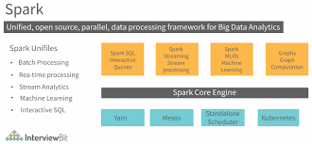
Architecture of Apache Spark
Source image taken from Interview Bit
Spark is offered as a software library that has 4 major modules, such as Spark SQL, Stream Processing, Mlib, GraphX where they can be deployed on any storage system such as Hadoop, Cloud object stores etc

Slide 27

Uses of Apache Spark
Spark is widely used in many productionized environments. Where multiple organizations are using it for processing unstructured, structured and semi structured data.
It is also offered as a service on cloud which is known as databricks.
It is primarily used for Batch, and stream processing.
Also, it performs extremely well on the batch data when compared to stream data.
Moreover, it has a SQL API which can be accessed data via Dataframes (In memory processing tool that has a programmability feature to query data).

Slide 28

Apache Flink - A Big Data Based Query processing Engine
The authors carbone et al. document and explain the architecture of Flink an open-source big data processing engine.
it uses a novel model of evaluation to process submitted jobs and are called dataflow graphs.
Flinks API supports 2 programming languages at most, they are java and scala.

Slide 29
Flink Core API's
Dataset API (Batch processing):
Flink performs batch processing on the system in a distinct
way where the, accrued data is processed using a stream biased
Engine.
Datastream API (Stream Processing):
Stream processing is referred as Datastream API where
continuous streamed data is stored and processed efficiently.

Slide 30
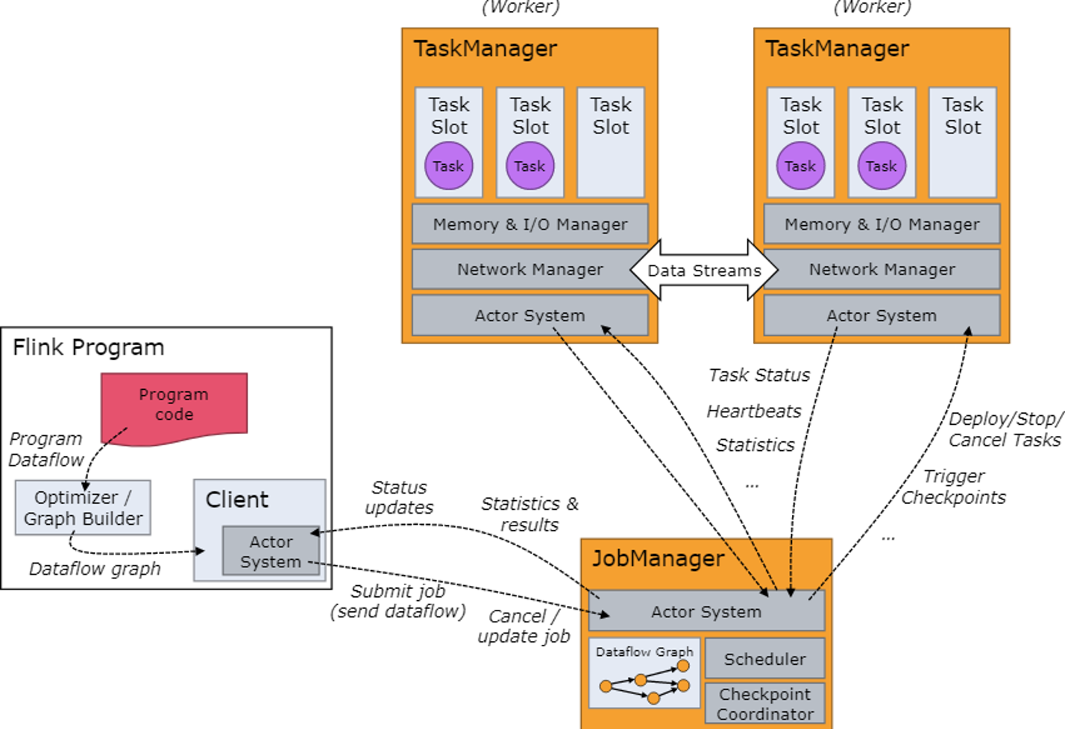
Flinks Architecture
Distributed processing: Apache Flink is designed to run large-scale distributed data processing applications. It uses a distributed architecture to parallelize data processing across multiple machines in a cluster.
Dataflow programming model: Flink uses a dataflow programming model, where data is processed as it flows through the system. In Flink, data is represented as streams or batches, and transformations are applied to the data as it moves through the system.
Streaming and batch processing: Flink supports both streaming and batch processing. It allows users to build data processing applications that can handle both real-time and batch data processing use cases.

Slide 31
Flinks Architecture - cont
Fault-tolerant processing: Flink provides fault-tolerant processing by replicating the data across multiple machines and ensuring that any failed processing tasks are automatically restarted on a different machine.
Memory management: Flink manages memory usage by allocating memory for each task based on the processing requirements. It uses a combination of on-heap and off-heap memory to optimize performance.
High-level APIs: Flink provides high-level APIs for Java and Scala that allow developers to build data processing applications quickly and easily. It also supports low-level APIs for fine-grained control over the data processing.
Integration with other systems: Flink integrates with other systems such as Apache Kafka, Apache Hadoop, and Apache Spark. It can read data from Kafka and Hadoop, and it can also write processed data to these systems.
Resource management: Flink provides resource management capabilities through the use of cluster managers such as Apache Mesos, Apache YARN, and Kubernetes. These managers allocate resources to Flink jobs and ensure that they are running efficiently.

Slide 32

Real Time Data infrastructure at Uber
Proposed by Soman et al. In the year 2021, that describes how Uber handles near real time, data processing internally.
The authors uses all the existing open source tools, such as Flink, Kafka, and Hadoop, and customized as per their needs.

Slide 33
Limitations of Existing Solutions
The available solutions offered by cloud vendors lack fault tolerance and scalability, which doesn’t fit into the need of Ubers infrastructure.
This triggered the need of creating, a novel real-time data infrastructure, using existing open source tools by customizing them as per the data needs.

Slide 34
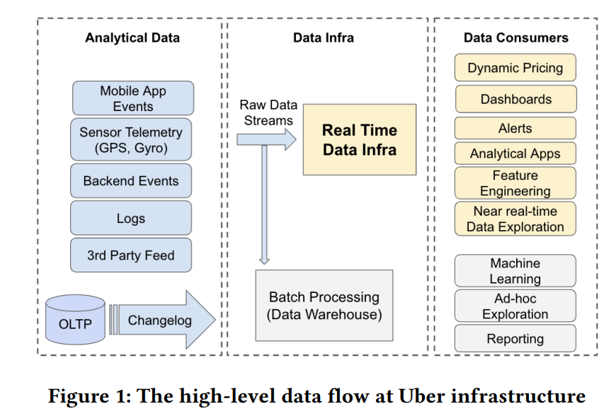
Data flow at Uber !

Slide 35
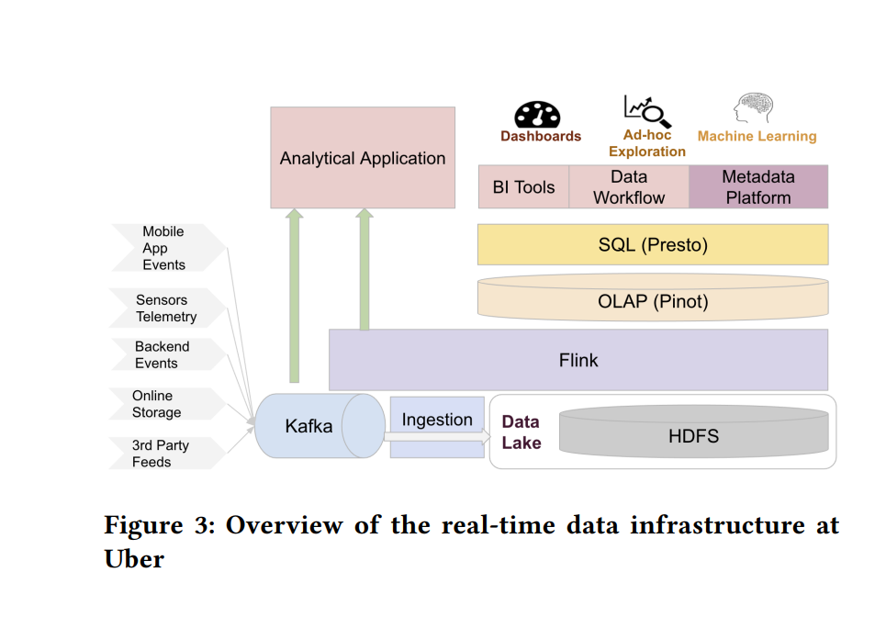
Overview of Infrastructure
For ingestion purposes the authors used Kafka, to store the incoming logs from multiple sources.
Later the ingested data is stored in data lake using HDFS instead of using object stores.
Thereafter, Flink is utilized to process the incoming streaming data.
Once the data is batched into the system, it is then sent to several layers based on necessity.
Example: BI tools for reporting, ML platform for prediction

Slide 36
Bibliography
[1]. Continuous Query Over Data Stream
[2]. Kafka: A Distributed messaging system for Log Processing
[3]. tsdb: A Compressed Database for Time Series
[4]. Apache Spark: A Unified Engine for Big Data Processing
[5]. Apache Flink™: Stream and Batch Processing in a Single Engine
[6]. Real-time Data Infrastructure at Uber

Slide 37
Thank You !
Waiting for Some awesome questions Please !

